Slide 1


PIANO TILES
By Astha Modi and Shobhit Sinha

Slide 2

GROUP DETAILS
Piano Tile is a single player
Game which is prepared using GUI concepts and basic Object Oriented
Programming Concepts.

Slide 3

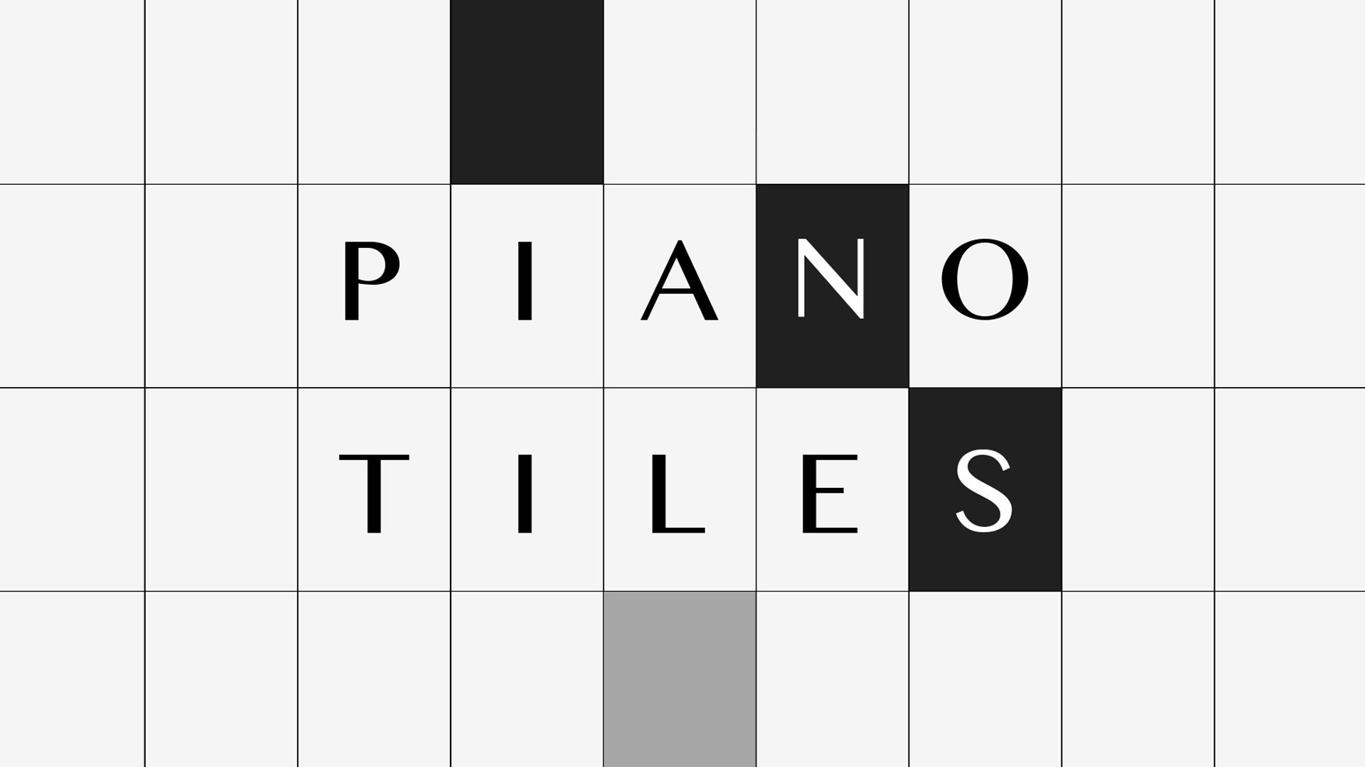
ABSTRACT
Piano Tiles(also known – Don’t Touch The White Tile) is a single player game which has simple control, a charming sound track and an incredible addictive game play made using simple concepts of Object Oriented Programming. It is a perfect mix of simplicity and addictive game play that’s easy to learn, but has a incredibly challenging to get high scores.

Slide 4
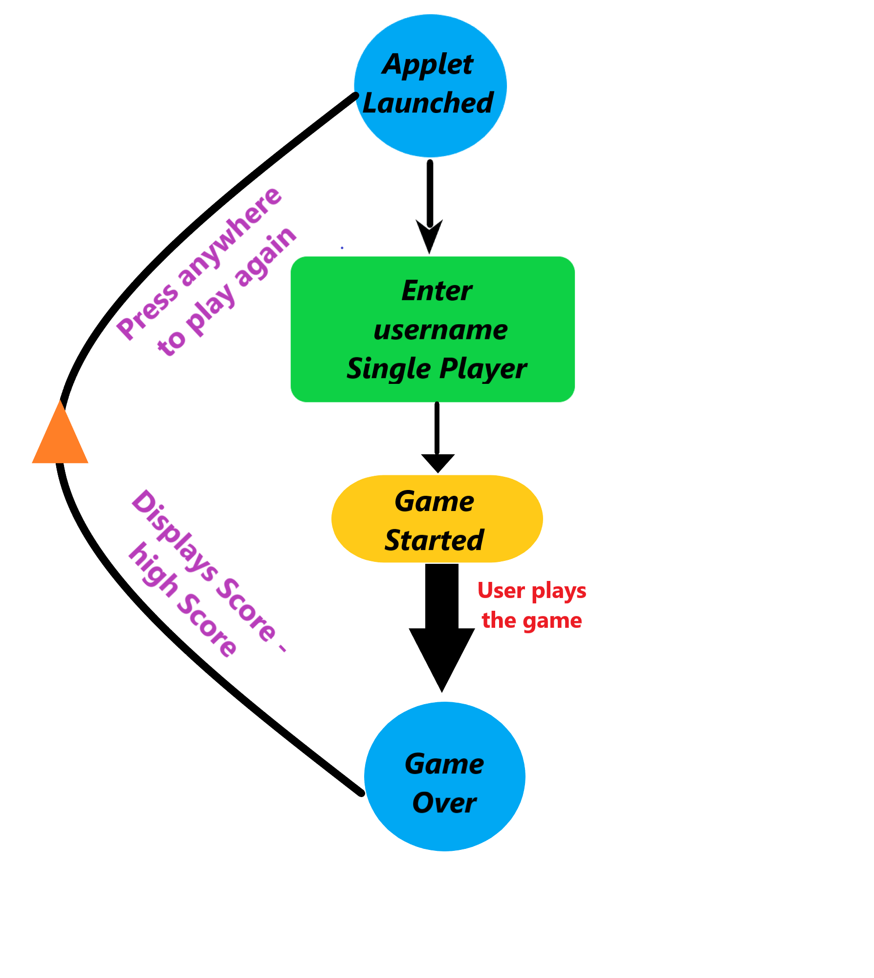
ROAD MAP

Slide 5
STEP BY STEP EXECUTION OF PIANO TILE
STEP 1:
As soon as the game is launched, a text box pops up asking the player for a username. Please make sure you select the username properly because this would be the assigned name of the user until the game is closed. The piano tile being a single player game will keep the username stored until the player exits the game. When the user enters the name and presses the OK button/ ENTER key which deploys a window on which the game is to be played appears on the left hand side of the display screen. Once again a text box pops up asking the player to be ready, as soon as ANY KEY is pressed the game would immediately evoke on the window.

Slide 6
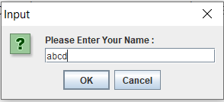
User enters name abcd

Slide 7

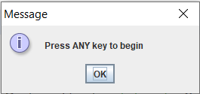
Whenever ready the user can press any key to start the game on the window which appeared on the left hand side of the display screen.

Slide 8
STEP 2:
At the start of the game, randomly arranged black and white tiles appear on the window. And at the top-and-centre of the window your score appears which would be presently zero, if the game has just begun. The music starts to play in the background, as soon as the game is started. The high score of the top left hand and left side of the window panel.

Slide 9
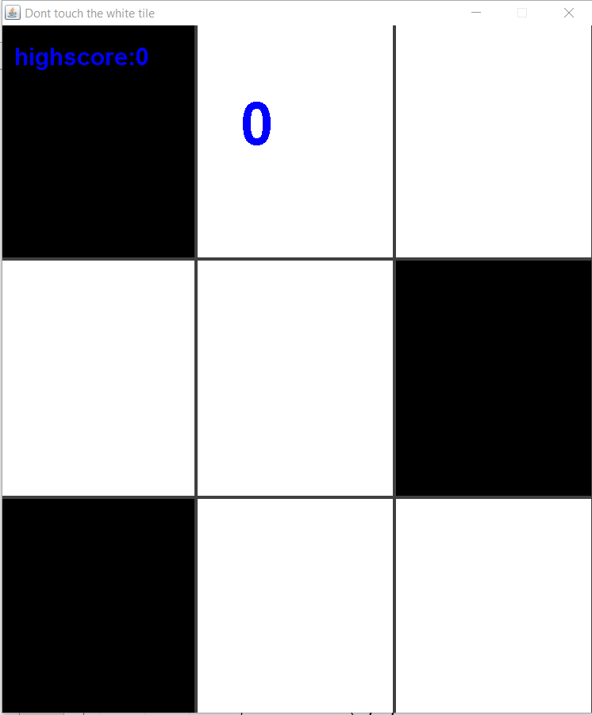
Game has just begun, music starts playing.

Slide 10
Step 3:
Piano tiles is a game where the player’s objective is to press on black tile visible in the lowermost row of the window, as they randomly appear on the top of the screen while avoiding white tile. When each black tile is pressed, the tiles on the screen automatically move and the player must keep up with the pace. The game lasts until one tile is missed in between, or a white tile is clicked/ pressed. As the player moves further in the game, the score automatically keeps on incrementing. As soon the game ends, the score of the player would be displayed.
If a user does not press any tile on the window for 10 seconds the game would automatically come to an end and take the user to the window where the score is displayed.

Slide 11
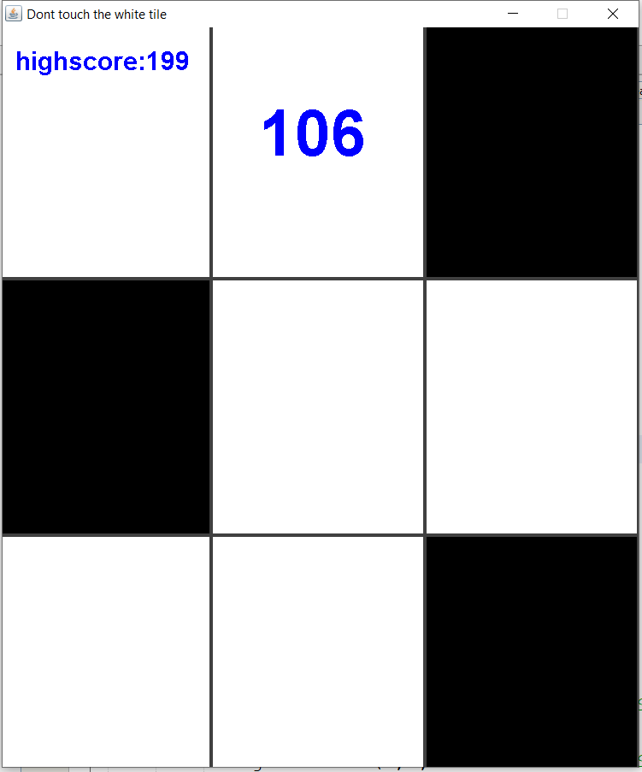
When the black tile is pressed the score automatically keeps on incrementing, high score can be seen on the top left corner.

Slide 12
STEP 4:
When the game comes to an end, it takes the user to the scorecard where the current score of the user is displayed. When the user is playing the game for the first time, the current score would be the high score of the game. A message is displayed indicating that the user has scored highest. If the user is not playing for the first time, if the user’s current score is greater than the high score of the game, then high score of the game is updated and is displayed as the high score with a congratulating message. If not only the current score of the user name will be displayed with a message.

Slide 13
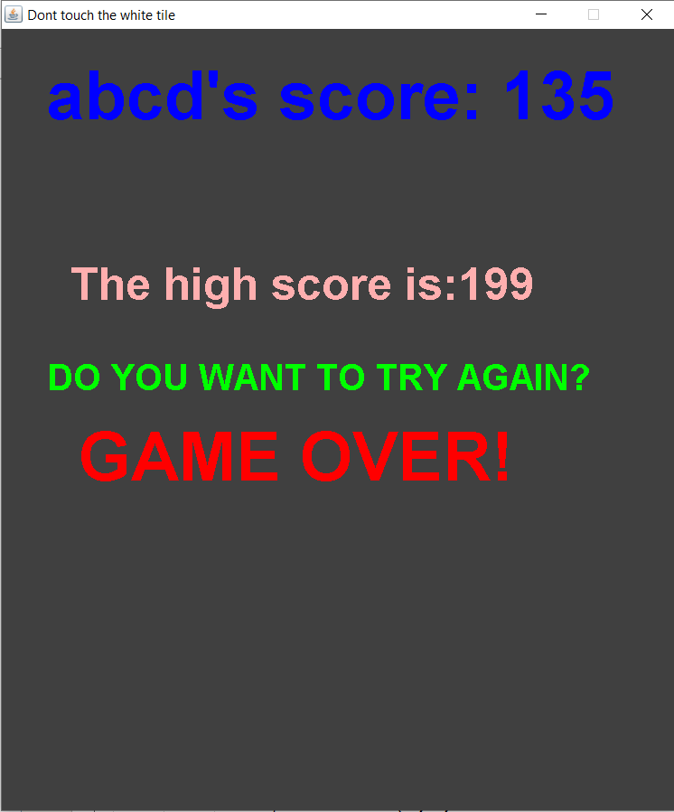
Game over, score displayed.

Slide 14
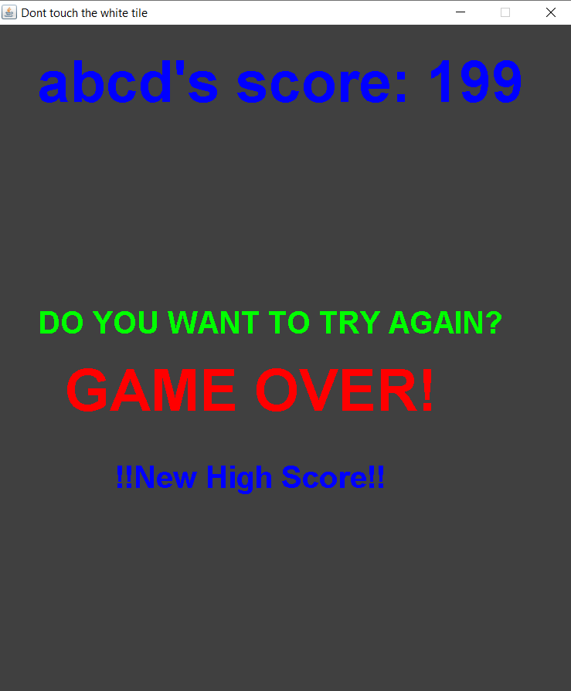
New high score created.

Slide 15
STEP 5:
The user can again re-start the play by pressing anywhere on the scorecard. When the user does so, again a text box pops up asking the user to press OK whenever the user is ready.
To exit the game at any point press the red cross button on the top right corner of the window which would abruptly terminate the game, exiting the window.

Slide 16
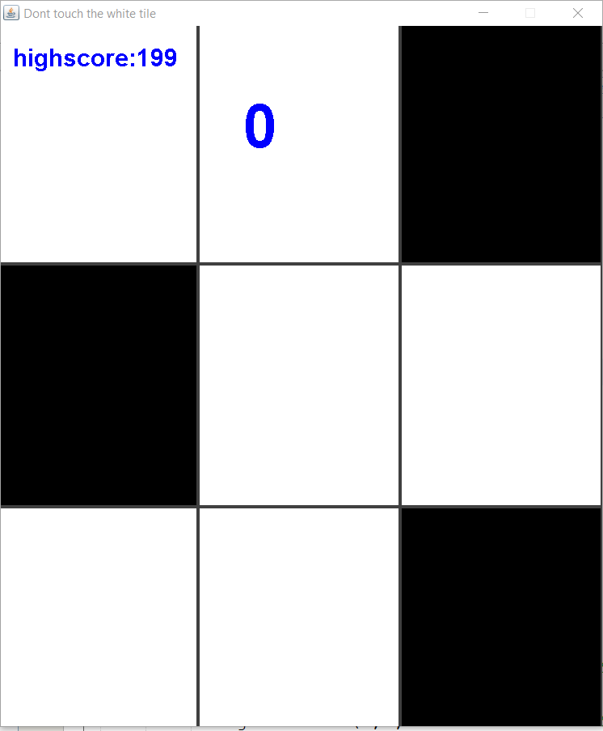
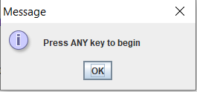
Playing Again!

Slide 17
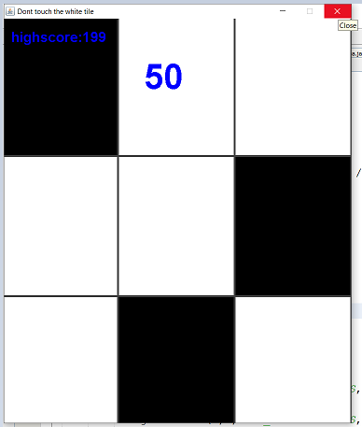
Abruptly closing the window.

Slide 18
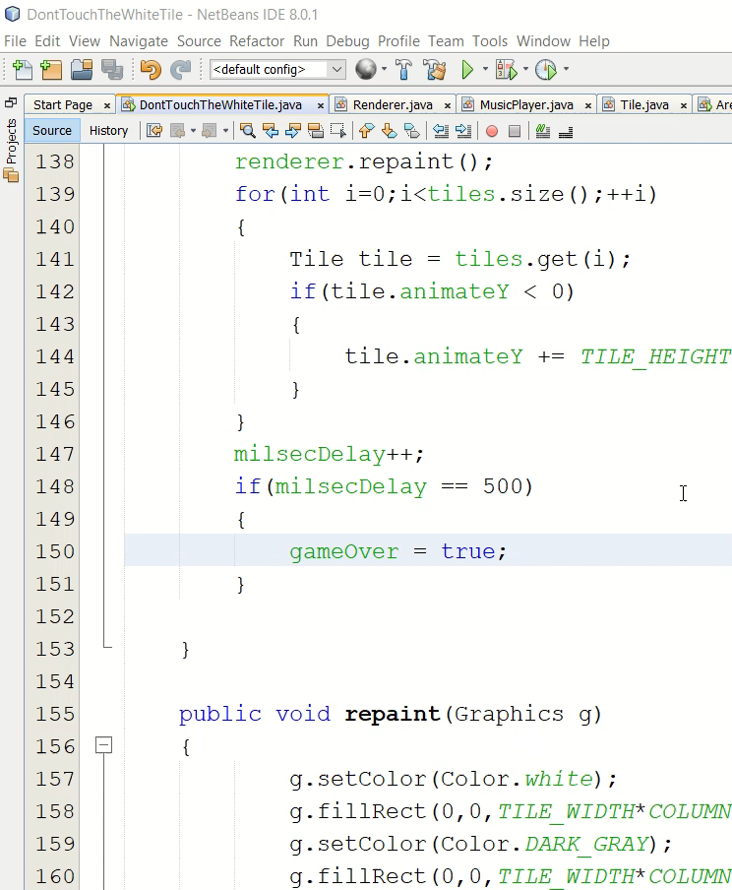
Screen Recording of the Piano Tiles.

Slide 19
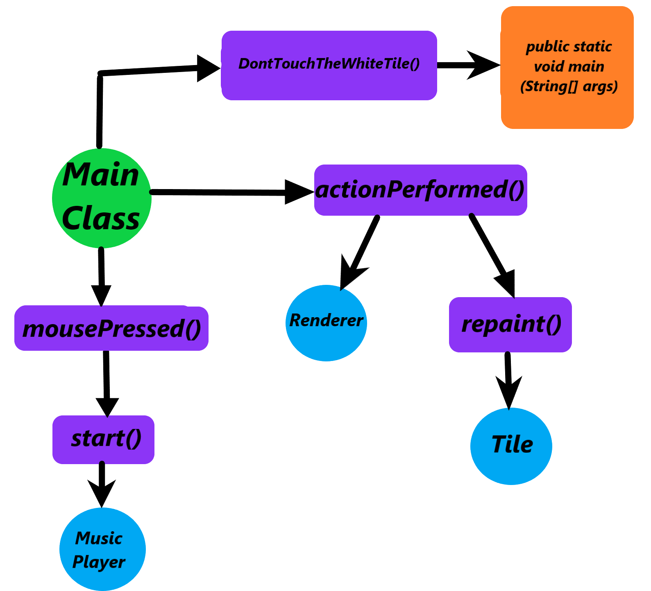
VARIOUS FUNCTIONALITIES IMPLEMNTED
BY
PIANO TILES

Slide 20
Main Class : DontTouchTheWhiteTile
This is the main class of the user interface. When this class is executed, the game is launched through this. It implements two java interfaces such as ActionListener and MouseListener. The constructor of this class initialises various variables which are used throughout the scope of program(shown in the table below). The constructor is also used to assign the player a username using the concept of JFrame. It creates a text file hscore.txt to maintain the high score of the game. It also handles the I/O Exception through a try and catch block. The methods of the JFrame like setVisible(), setSize(), setResizable(), addMouseListener(), setDefaultCloseOperation(JFrame.EXIT_ON_CLOSE) are implemented here. A Timer thread implements a method called start().

Slide 21
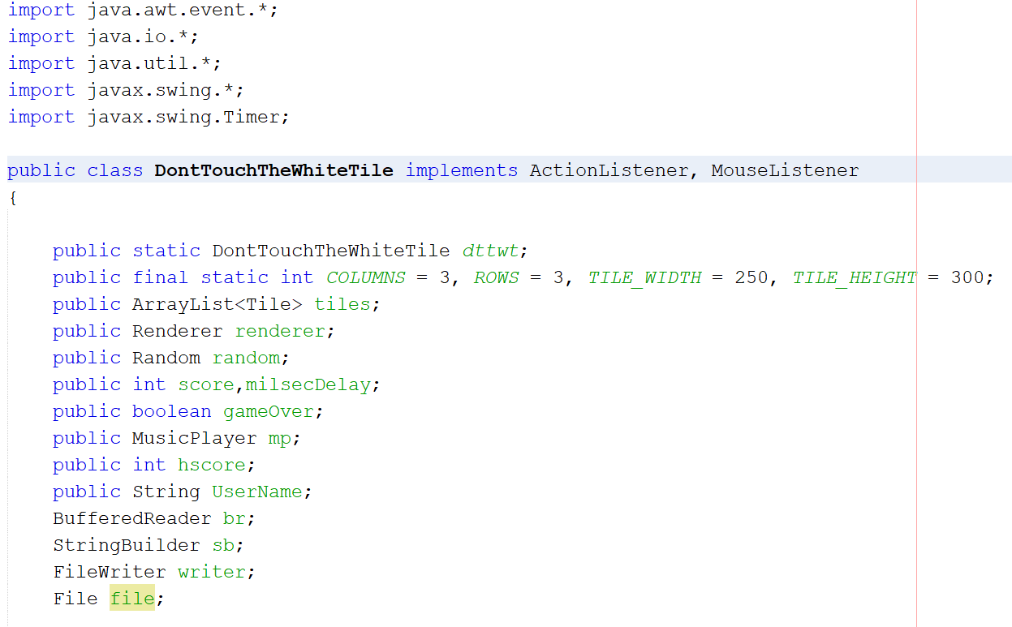

Slide 22
DontTouchTheWhiteTile (Continued):
As this class implements mouseListener interface it is a compulsion to add all of it’s abstract methods, irrespective of the fact they have a definition or not. The methods are as follows:-
- mouseClicked()
mousePressed()
mouseReleased()
mouseEntered()
mouseExited()
Every method except the mousePressed() method is kept empty as there is no use of them in the project.

Slide 23
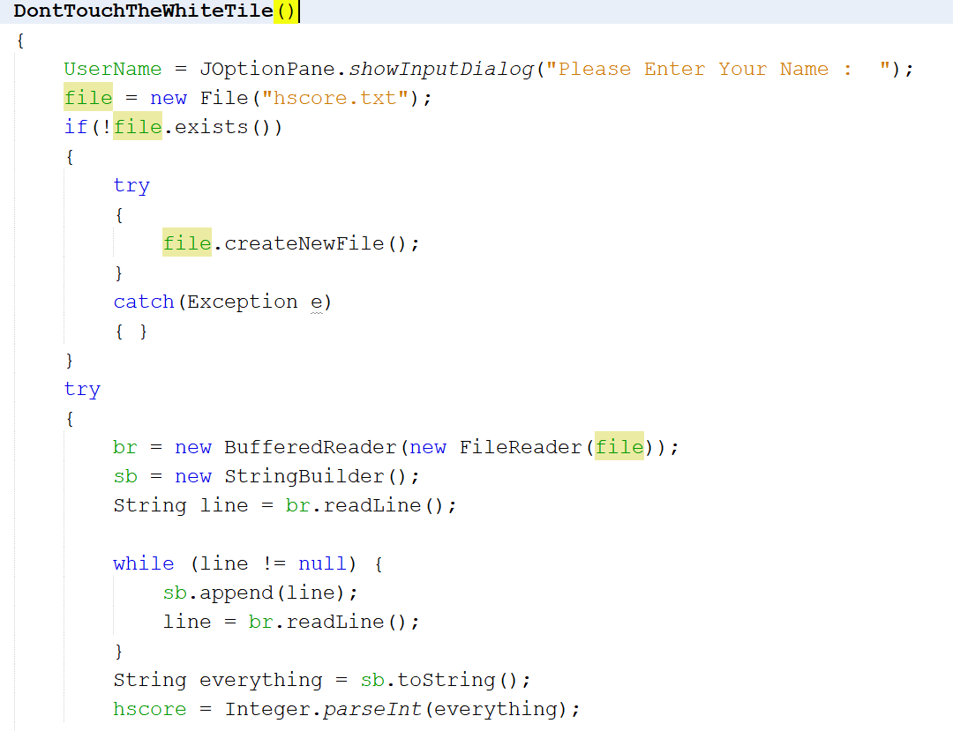

Slide 24
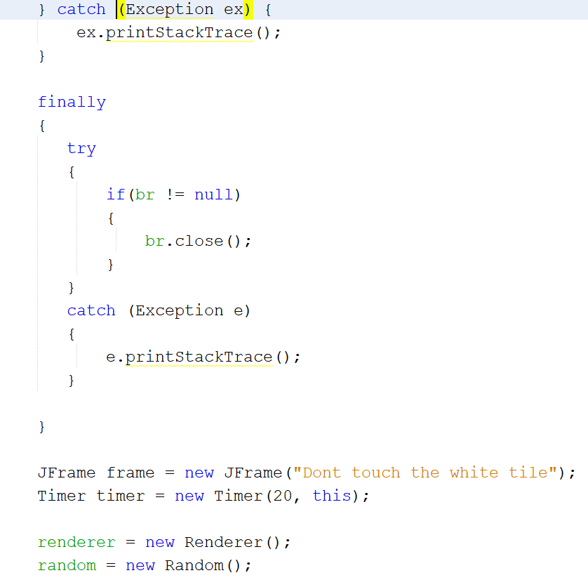

Slide 25
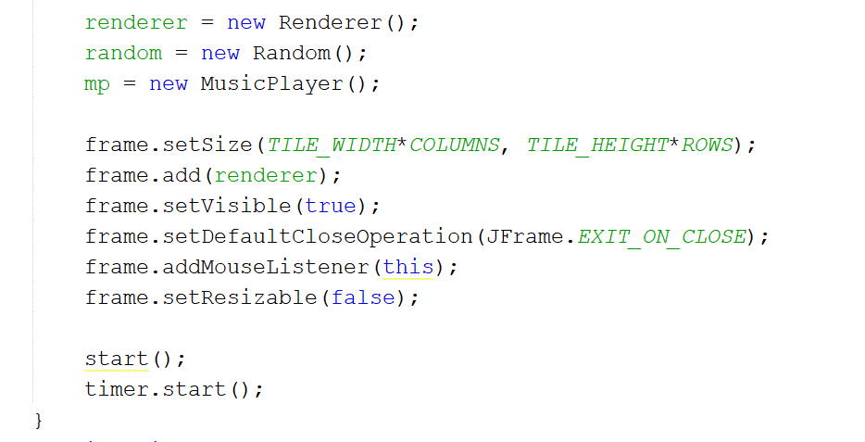

Slide 26
MousePressed Method :
public void mousePressed(MouseEvent e)
If the user follows the instruction given in the game manual the game continues and the tiles keep on coming from the top of the window and the score is calculated that can be seen above according to the time taken by the user to press a tile. If a white tile is presses or a black tile is missed then the game comes to an end displaying the score count. If the user wants to play the game again after the scorecard has been displayed, this method calls the start() method when the user clicks anywhere on the score card.

Slide 27
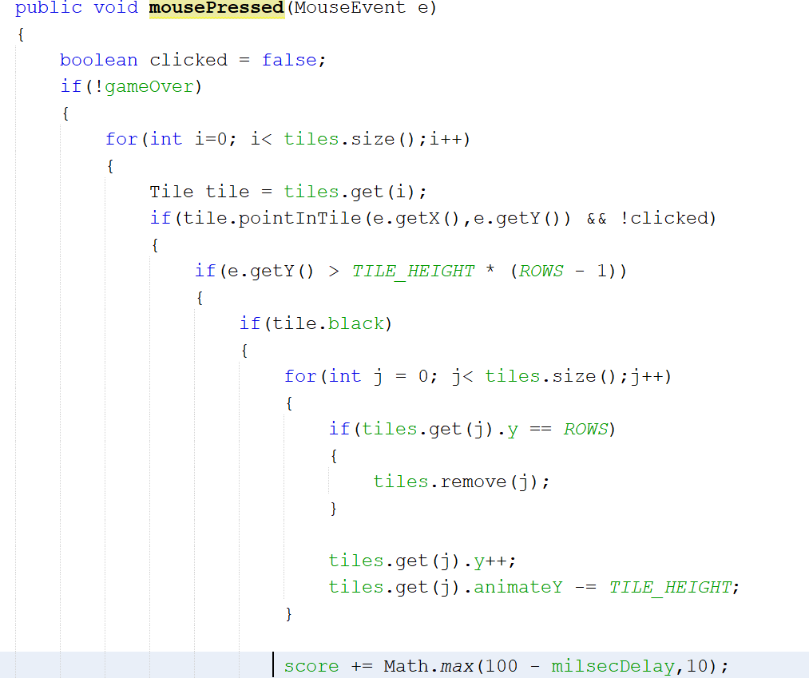

Slide 28
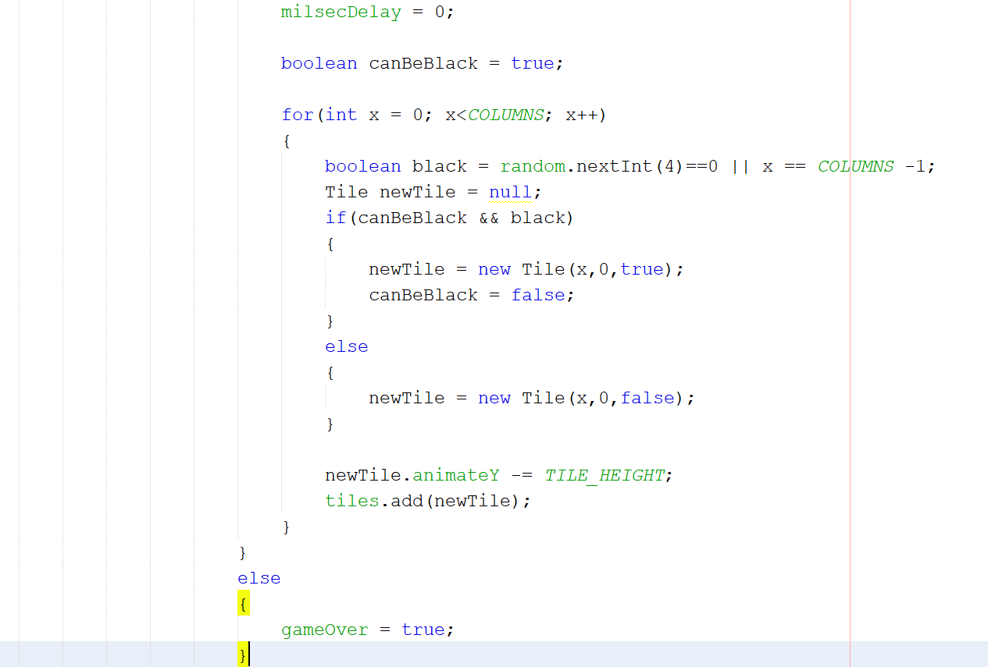

Slide 29
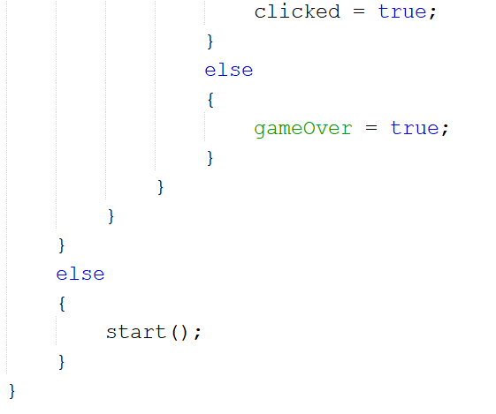

Slide 30
Start method: public void start()
It provides the basic layout of piano tiles game, in a set of three. In this method, two nested loops run for an infinite amount of time which automatically adds a new set of three tiles from above in a random manner until the game ends. A method named play() is called which plays the music in the background until the game is exited.

Slide 31
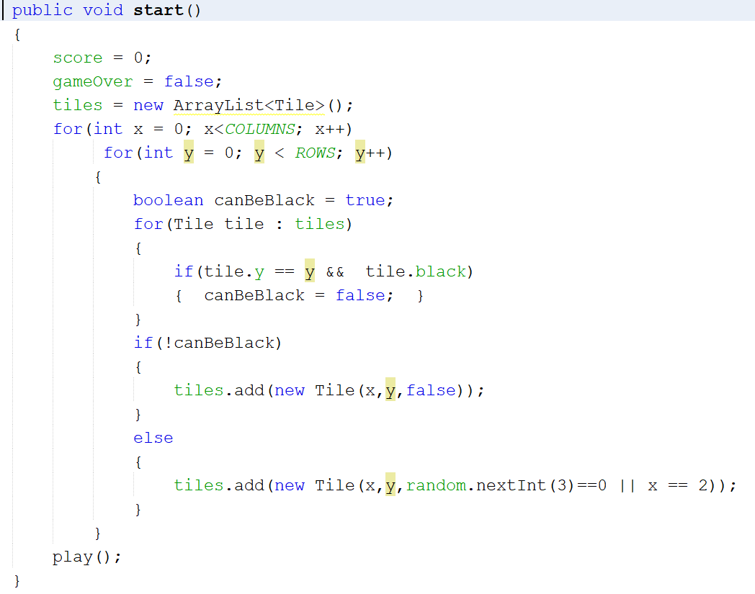

Slide 32
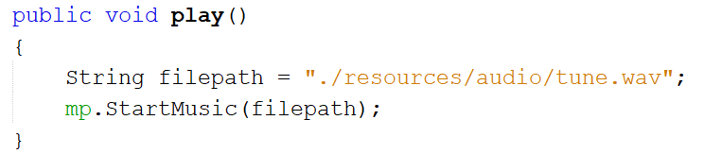
Play method: public void play()
This method plays a particular song until the user exits the game. The logic of the play method is implemented through class MusicPlayer.

Slide 33
Class MusicPlayer
This java class plays a particular tune of the music which is already stores at a particular location. A try and a catch block is used to handle the file exception error i.e. suppose the file cannot be found at the location.

Slide 34
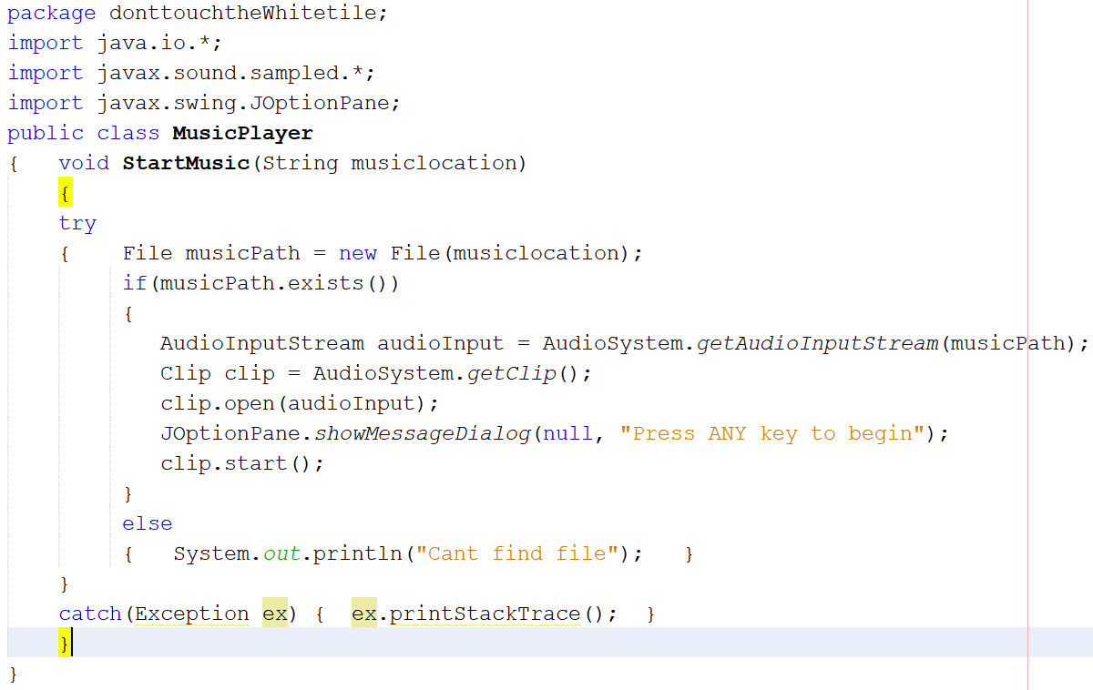

Slide 35
ActionPerformed method:
public void actionPerformed(ActionEvent e)
This method calls the Renderer class using the repaint method. It is responsible for the size of the tile that are generated through the class Tile. It also has a parameter that suppose, the user is not performing any operation for a delay of some seconds, then the game will automatically come to an end.

Slide 36
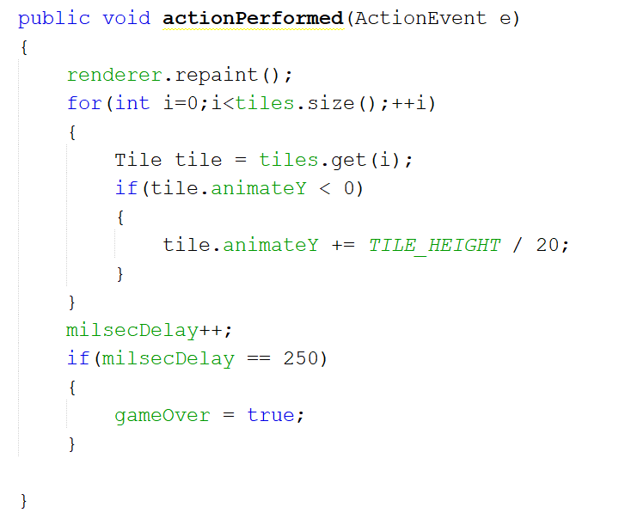

Slide 37
Class Tile
This class is responsible for the height and width of the tile which are generated using the actionPerformed method through a boolean method called pointInTile.
Class Renderer
Renderer class extends JPanel which is a child class of JComponent and the interface Accessible. An object of this class is created to access the repaint method.

Slide 38
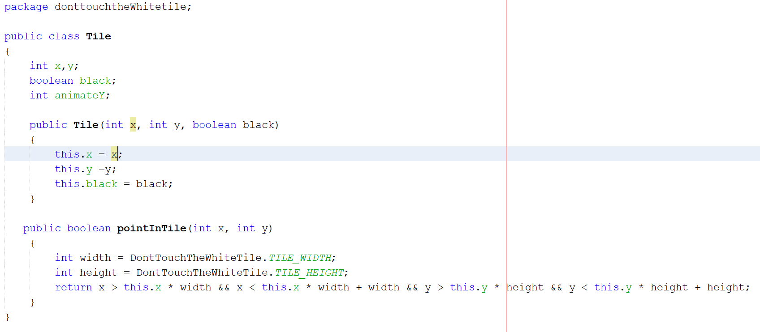

Slide 39
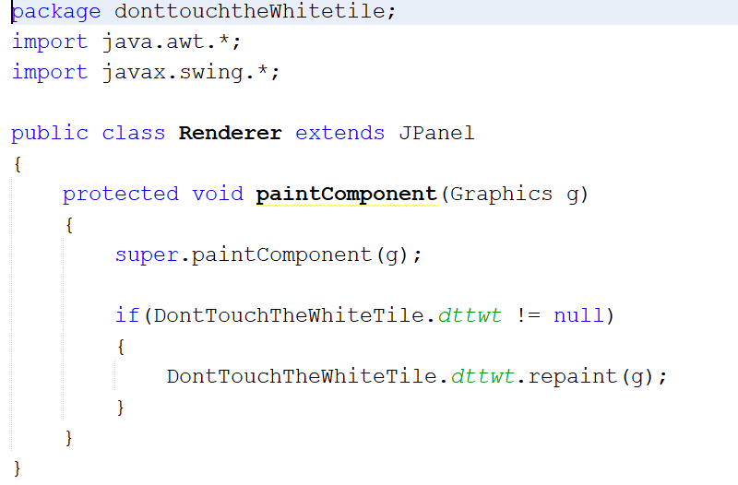

Slide 40
Repaint method : public void repaint(Graphics g)
Everything that is on the canvas, is portrayed using repaint method. It also display the score card. It automatically updates the high score in the file hscore.txt while also handling the file exception using a try and catch. Everything that is displayed on the canvas like the background, the message, the score of the player, the colour of tiles is implemented using this method.

Slide 41
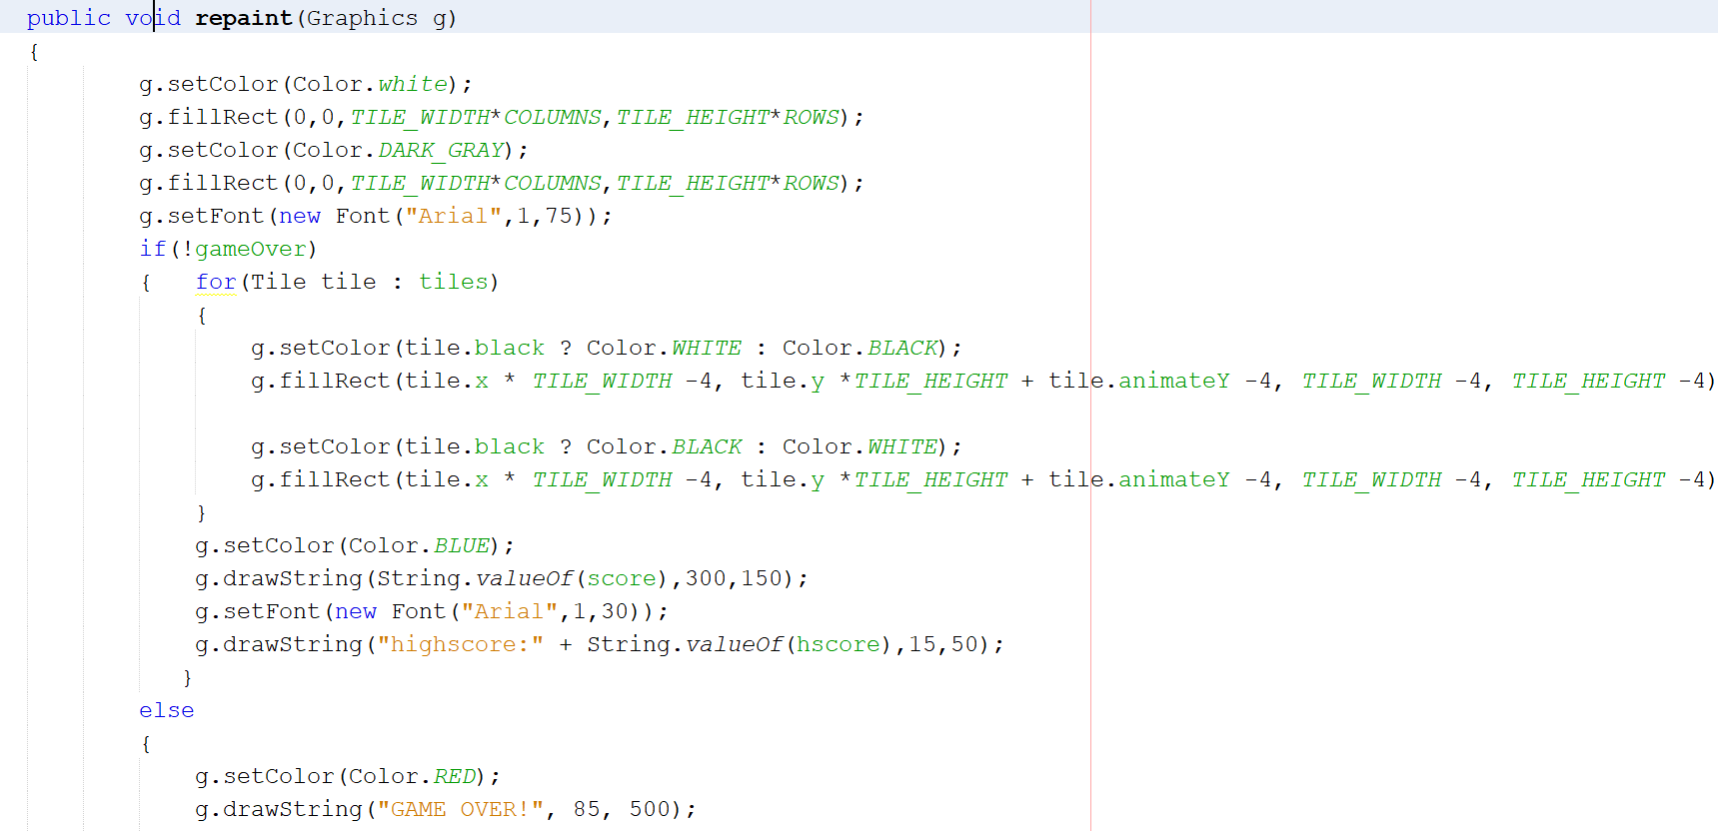

Slide 42
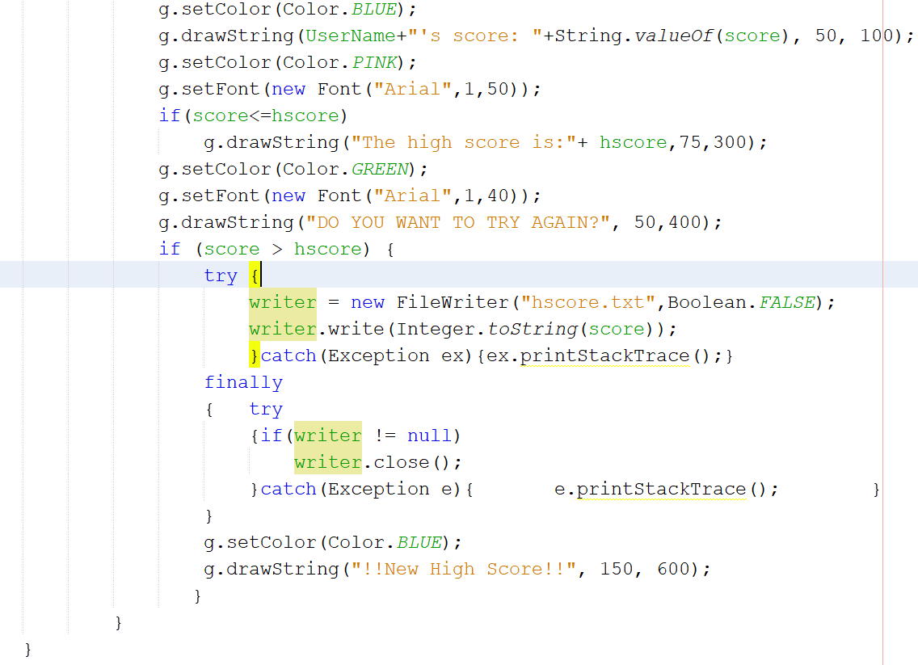

Slide 43
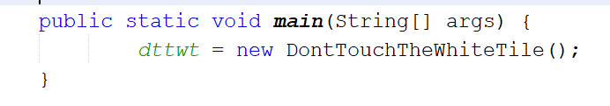
Main method: public static void main(String[] args)
An object dttwt of the type DontTouchTheWhiteTile is created which is responsible for starting the main thread of the program.

Slide 44
VARIABLE NAME | TYPE OF VARIABLE | USED FOR
dttwt | DontTouchTheWhiteTile | To initialize the main thread
COLUMNS | Integer | Numbers of columns of tiles
ROWS | Integer | Number of rows of tiles
TILE_WIDTH | Integer | Width of the tile
TILE_HEIGHT | Integer | Height of the tile
tiles | ArrayList<Tile> | Creating continuous tiles
renderer | Renderer | Access object of repaint()
random | Random | Generating pattern of tiles
score | Integer | Maintaining current score
milsecDelay | Integer | Calculating score
gameOver | Boolean | Checking if game is running
mp | MusicPlayer | Playing music
UserName | String | Entering name
hscore | Integer | Maintaining highest score
TABLE OF VARIOUS VARIABLES USED

Slide 45
Table for Exception Handling
TYPE OF EXCEPTION HANDLED | TASK FOR WHICH EXCEPTION IS HANDLED | LOCATION
FileNotFoundException | It is used when the high score has to be entered(input) and the file hscore.txt is not found then the error message is displayed. When the high score has to be updated and the hscore.txt file’s location is wrong or the file is not found then the error message is displayed. | Constructor of don’t touch the white tile. Repaint method [repaint()]
IOException | When the high score is entered and something goes wrong while and when input operation is failed or interrupted then a message is displayed that there was an error in input/output of the data. When the high score is updated and something goes wrong and when output operation is failed or interrupted then a message is displayed that there was an error in input/output of the data. | Constructor Repaint method

Slide 46
Implementation Details
GUI Used | List of components used in GUI
Swing | JFrame Jpanel JOptionPane.showInputDialog
Events handled | Method used
MouseListener | MousePressed() is invoked when the mouse button has been pressed on a component i.e. the black/white tile. All the other methods are kept null.
ActionListener | ActionPerformed() is implemented to fix the size of the tiles that are to be generated.

Slide 47
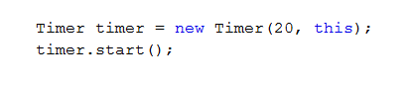
DETAILS OF MULTI-THREADING
Timer class provides a method call that is used by a thread to schedule a task, such as running a block of code after some regular instant of time. Each task may be scheduled to run once or for a repeated number of executions. Each timer object is associated with a background thread that is responsible for the execution of all the tasks of a timer object.
Timer class is thread-safe.
Timer class uses binary heap data structure in order to store its task.

Slide 48
Details of File Handling
FileWriter class is a class which is used to write in the high score in the file hscore.txt. File class is used to open the file hscore.txt. BufferedReader class is used to read the high score from the class and StringBuilder class is used to create a mutable sequence of characters and store it in the String variable line.

Slide 49

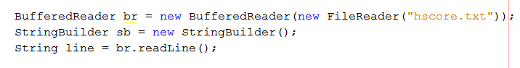


Slide 50
Details of interface/class
CLASS NAME | INTERFACES IMPLEMENTED / CLASSES EXTENDED
DontTouchTheWhiteTile | Interfaces implemented: ActionListener MouseListener
Renederer | Class Extended: JPanel
Tile | -
MusicPlayer | -

Slide 51
THANK YOU

